Slide 1
Economic impacts
Science and scenarios
Abatement costs
Instruments for emission reduction
Impacts of climate change; valuation
Economic impacts; marginals; distribution
Impacts and development
Adaptation policy
Optimal climate policy
Discounting, equity, uncertainty

Slide 2
Economic impacts
Why estimate the total economic impact of climate change?
Methods
Results and caveats
Weather v climate
Social cost of carbon
Distribution of impacts
Schelling conjecture
Impact on economic growth
Climate and development

Slide 3
Impacts of Climate
Climate change has many different impacts, with different effects for different countries, sectors, times
If one wants to get insights, high level indicators need to be used

Slide 4
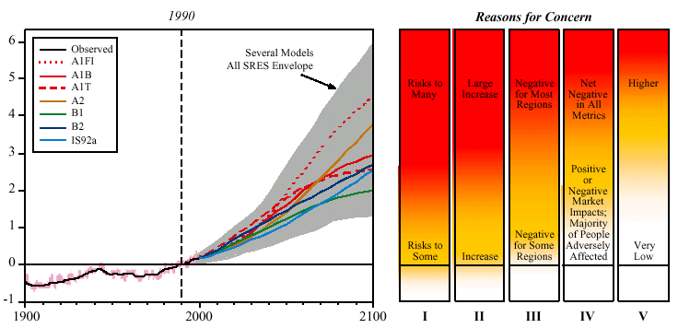
Global mean warming ºC
Year
I Risks to Unique and Threatened Systems
II Risks from Extreme Climate Events
III Distribution of Impacts
IV Aggregate Impacts
V Risks from Future Large-Scale Discontinuities
Source: IPCC 2001

Slide 5
Impacts of Climate
Climate change has many different impacts, with different effects for different countries, sectors, times
If one wants to get insights, high level indicators need to be used
If one wants to compare the impacts of climate change to the impacts of emission reduction, impose the Pigou tax, include the impacts in the national accounts, or determine how much compensation should be paid, money is the appropriate indicator

Slide 6
Economic impacts
Why estimate the total economic impact of climate change?
Methods
Results and caveats
Weather v climate
Social cost of carbon
Distribution of impacts
Schelling conjecture
Impact on economic growth
Climate and development

Slide 7
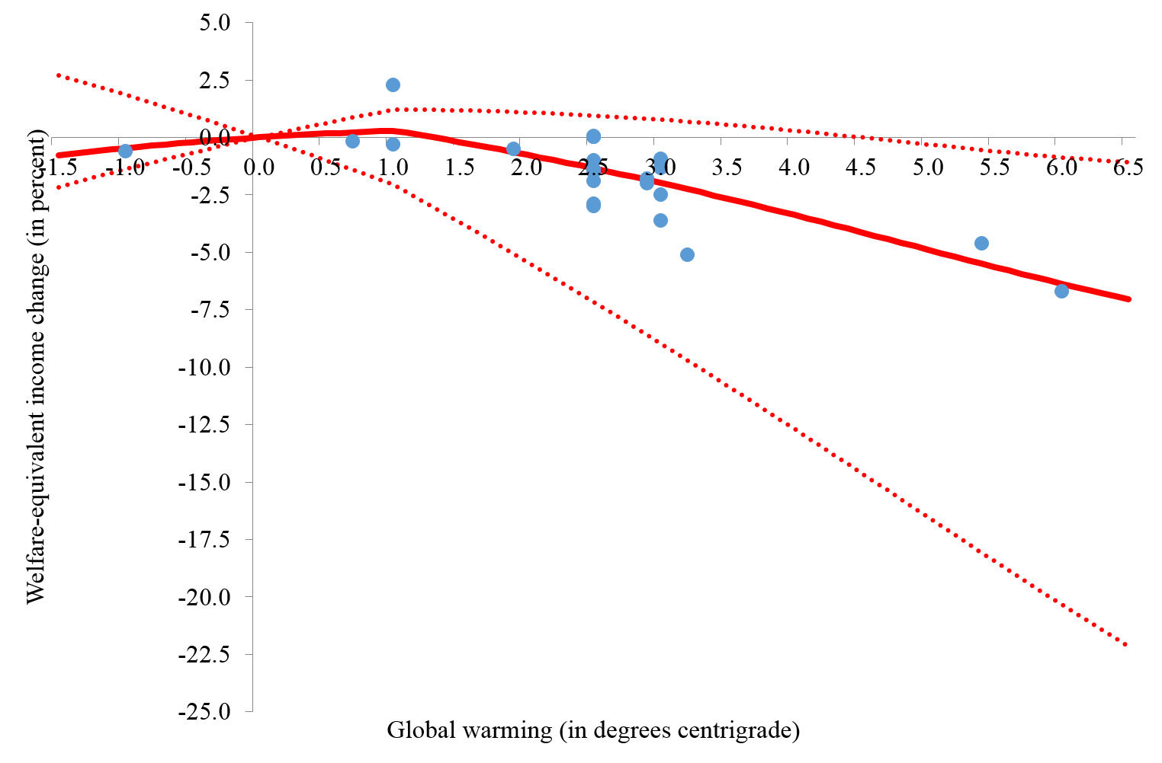

Slide 8

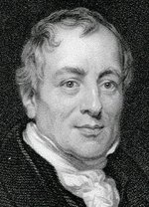
Methods
Enumerative method
Quantify impact, estimate price, add up
Computable general equilibrium
Quantify impact, shock model, estimate welfare change
Elicitation method
Ask experts
Statistical method
Estimate relationship between activity and climate over space, assume it holds over time
Estimate relationship between well-being and climate

Slide 10
Economic impacts
Why estimate the total economic impact of climate change?
Methods
Results and caveats
Weather v climate
Social cost of carbon
Distribution of impacts
Schelling conjecture
Impact on economic growth
Climate and development

Slide 11
Initial impacts may be positive
Later impacts clearly negative
Disagreement on details,
agreement on order of magnitude
Large, asymmetric uncertainty

Slide 12
Caveats
Incomplete assessment
Interactions between impacts
Stylised adaptation
Low probability, high impact
Indirect impacts
Large-scale changes

Slide 14
Economic impacts
Why estimate the total economic impact of climate change?
Methods
Results and caveats
Weather v climate
Social cost of carbon
Distribution of impacts
Schelling conjecture
Impact on economic growth
Climate and development

Slide 16
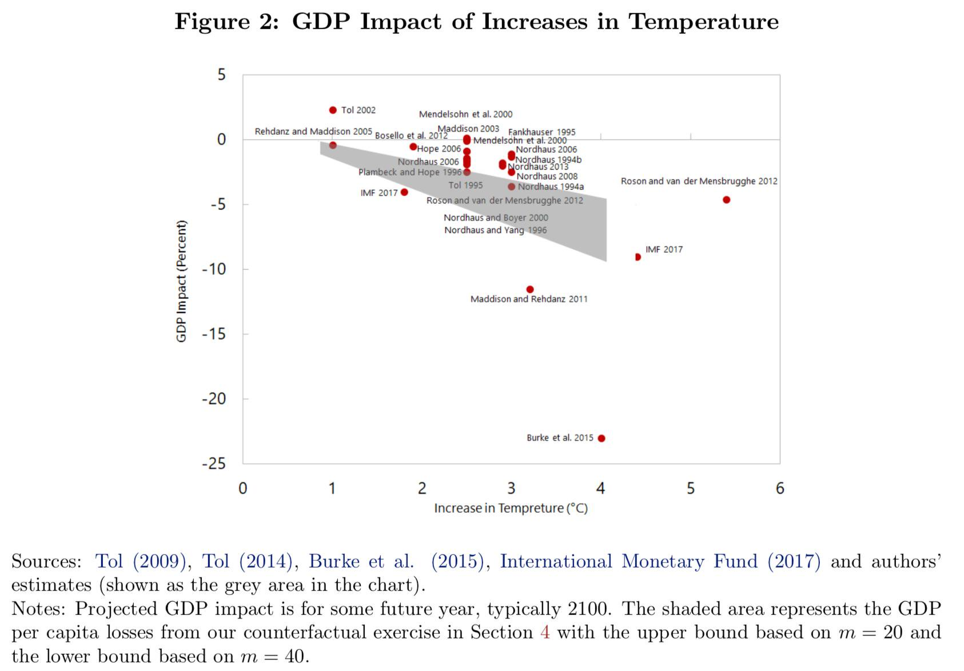



Slide 17
Weather v climate
Estimating the impact of climate change is difficult because it changes slowly over time, while differences over space are confounded with all sorts of everything
Estimating the impact of weather is easy because data is plentiful and shocks are random (or rather orthogonal to the economy)
Extrapolating from weather shocks to climate change is problematic

Slide 18
Weather v climate
Extrapolate from weather shocks to climate change?
Climate is what you expect, weather is what you get
Weather throws the punches, climate trains the boxer
Weather is your mood, climate is your personality
If you don't like the weather, wait. If you don't like the climate, move.
Adaptation is different
Put up your umbrella, buy an umbrella
Close the flood gates, build flood gates
Short-term vs long-term elasticity
Fixed vs malleable capital stock, technology, institutions
Expectations matter too

Slide 19
Economic impacts
Why estimate the total economic impact of climate change?
Methods
Results and caveats
Weather v climate
Social cost of carbon
Distribution of impacts
Schelling conjecture
Impact on economic growth
Climate and development

Slide 21
Marginal Damage Costs
The marginal damage cost is the damage done by an additional tonne of CO2 emitted
It is the change in the net present value of the monetised impacts, normalised by the change in emissions
If evaluated along the optimal emission trajectory, the marginal damage cost is the Pigou tax – it says how much we should spend on climate policy, by how much we should raise energy prices
It is a normative concept; it tells us what to do, given our values

Slide 22
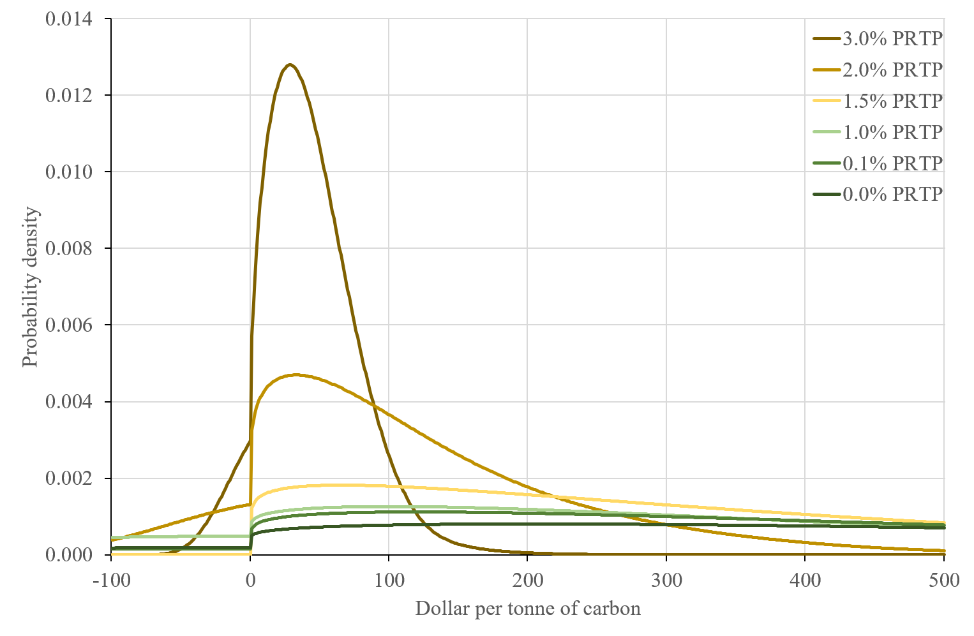

Slide 23
Why so many estimates?
There are 27 estimates of the total costs of climate change, and over 1300 of its first partial derivative, the social cost of carbon
An estimate of the social cost of carbon requires
Not just a point estimate, but an impact function
A model of the impact of emissions on concentrations, and concentrations on climate
Scenarios of emissions, population, income
Aggregation over time, over people, over futures

Slide 25
Social cost of carbon, $/tC
PRTP | Mode | Mean | SD
0% | 202 | 686 | 644
1% | 100 | 378 | 471
3% | 28 | 43 | 35
EU | 102 | Oct | 2020
California | 62 | Oct | 2020
Shenzen | 18 | Oct | 2020

Slide 26
